Slide 1

LECTURE 6: Domain Modeling
Instructor:
Maria Striki
Presentation: Maria Striki, Ivan Marsic
Rutgers University

Slide 2
Topics
Identifying Concepts
Concept Attributes
Concept Associations
Contracts: Preconditions and Postconditions

Slide 3
Domain Modeling
Why? —The goal of domain modeling is to understand how system-to-be will work
  Requirements analysis determined how users will interact with system-to-be (external behavior)
  Domain modeling determines how elements of system-to-be interact (internal behavior) to produce the external behavior
How? —We do domain modeling based on sources:
  Knowledge of how system-to-be is supposed to behave (from requirements analysis, e.g., use cases)
  Studying the work domain (or, problem domain)
  Knowledge base of software designs
  Developer’s past experience with software design

Slide 4
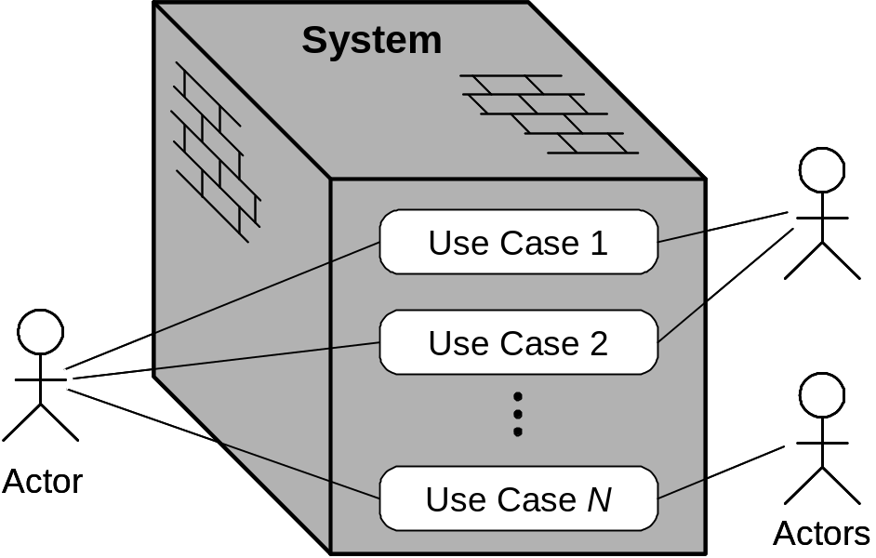
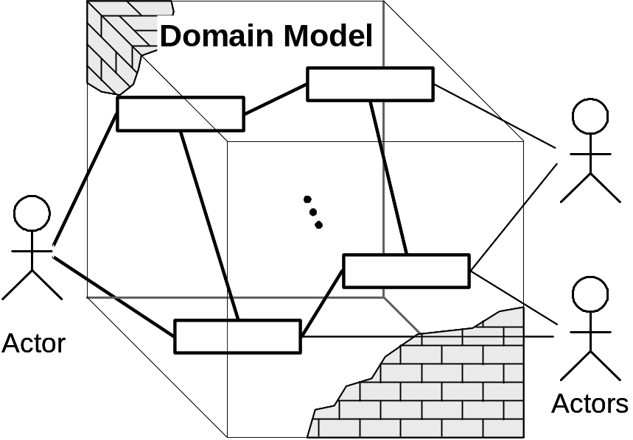
Use Cases vs. Domain Model
In use case analysis, we consider the system as a “black box”
In domain analysis, we consider the system as a “transparent box”
(a)
(b)

Slide 5
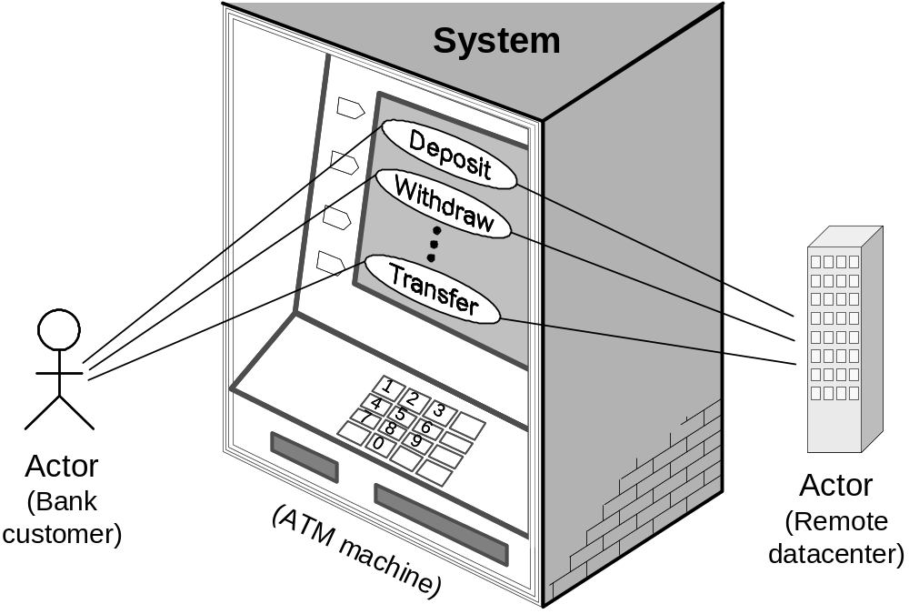
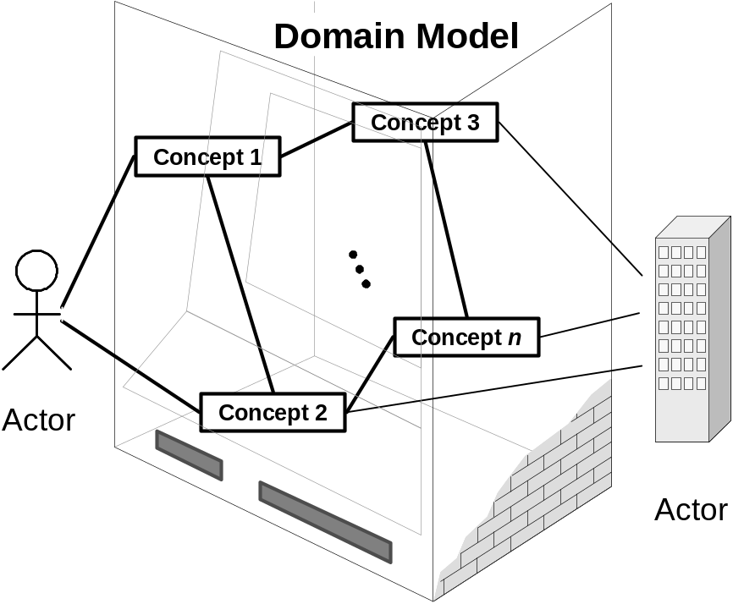
Example: ATM Machine
(b)
(a)

Slide 6
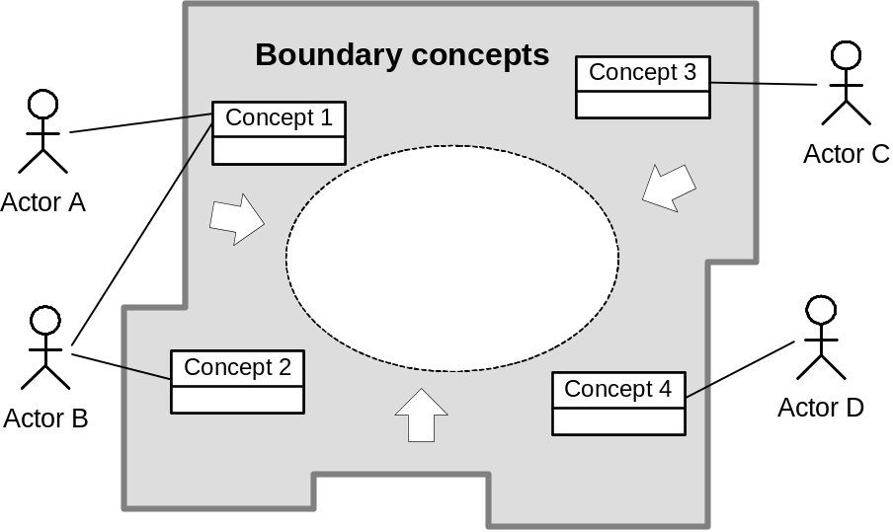
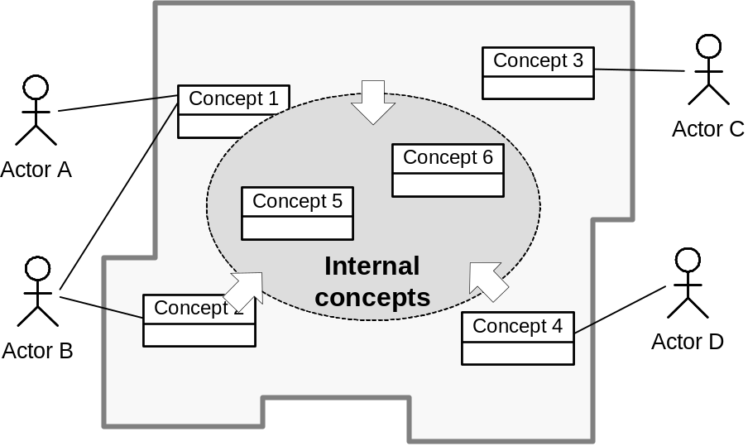
Building Domain Model from Use Cases
Step 1: Identifying the boundary concepts
Step 2: Identifying the internal concepts

Slide 7
Use Case 1: Unlock
Use Case UC-1: |  |  | Unlock
Related Requirements: |  |  | REQ1, REQ3, REQ4, and REQ5 stated in Table 2-1
Initiating Actor: |  |  | Any of: Tenant, Landlord
Actor’s Goal: |  |  | To disarm the lock and enter, and get space lighted up automatically.
Participating Actors: |  |  | LockDevice, LightSwitch, Timer
Preconditions: |  |  | • The set of valid keys stored in the system database is non-empty. • The system displays the menu of available functions; at the door keypad the menu choices are “Lock” and “Unlock.”
Postconditions: |  |  | The auto-lock timer has started countdown from autoLockInterval.
Flow of Events for Main Success Scenario:
→ | 1. | Tenant/Landlord arrives at the door and selects the menu item “Unlock”
 | 2. | include::AuthenticateUser (UC-7)
← | 3. | System (a) signals to the Tenant/Landlord the lock status, e.g., “disarmed,” (b) signals to LockDevice to disarm the lock, and (c) signals to LightSwitch to turn the light on
← | 4. | System signals to the Timer to start the auto-lock timer countdown
→ | 5. | Tenant/Landlord opens the door, enters the home [and shuts the door and locks]

Slide 8
Extracting the Responsibilities
Responsibility Description | Type | Concept Name
Coordinate actions of all concepts associated with a use case, a logical grouping of use cases, or the entire system and delegate the work to other concepts. | D | Controller
Container for user’s authentication data, such as pass-code, timestamp, door identification, etc. | K | Key
Verify whether or not the key-code entered by the user is valid. | D | KeyChecker
Container for the collection of valid keys associated with doors and users. | K | KeyStorage
Operate the lock device to armed/disarmed positions. | D | LockOperator
Operate the light switch to turn the light on/off. | D | LightOperator
Operate the alarm bell to signal possible break-ins. | D | AlarmOperator
Block the input to deny more attempts if too many unsuccessful attempts. | D | Controller
Log all interactions with the system in persistent storage. | D | Logger

Slide 9
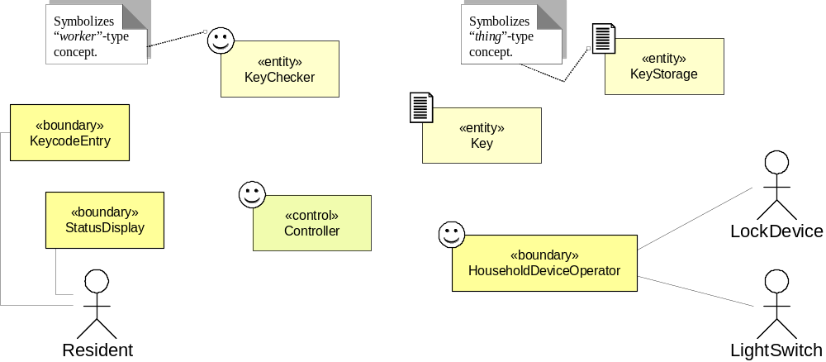
Domain Model (1)
Domain concepts for subsystem #1 of safe home access

Slide 10
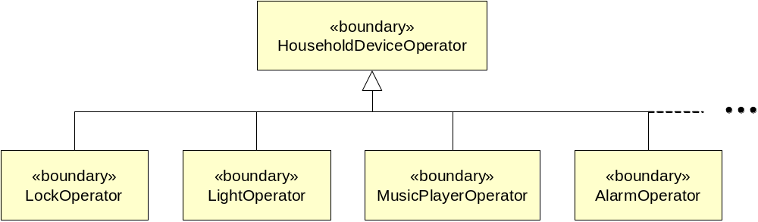
Domain Model (2)

Slide 11
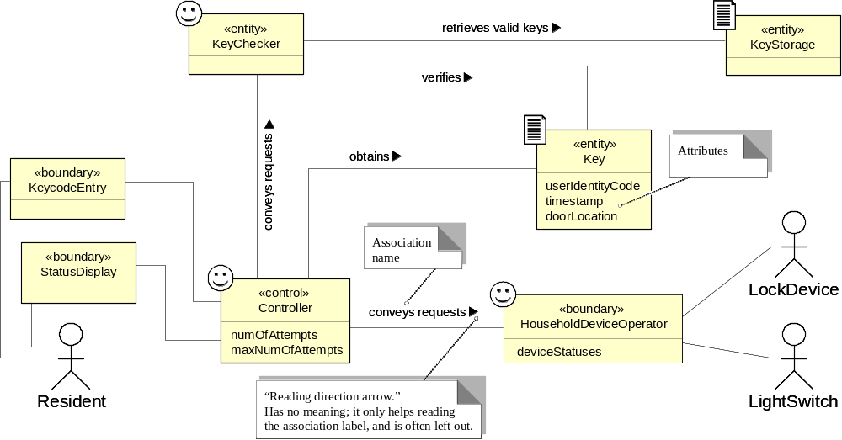
Domain Model (3a)
Domain model for UC-1: Unlock
Associations: who needs to work together, not how they work together
Concept pair | Association description | Association name

Slide 12
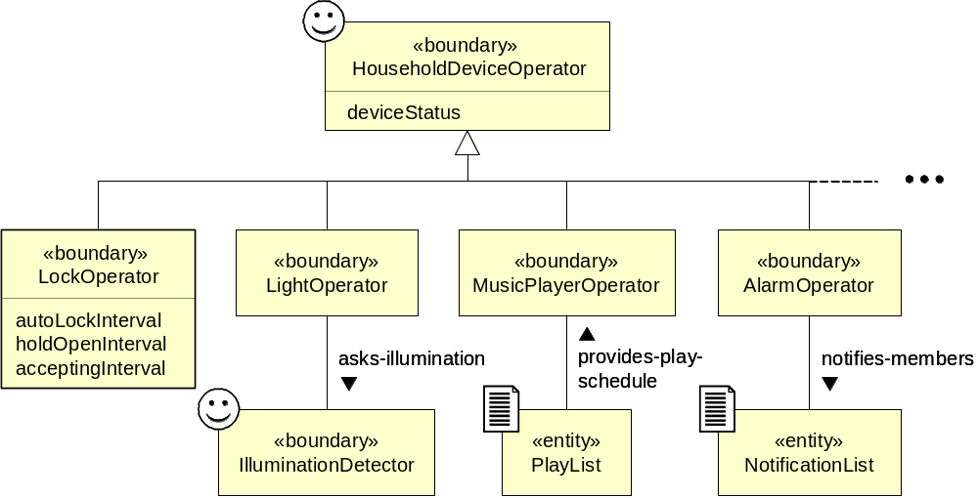
Domain Model (3b)

Slide 13
Use Case 5: Inspect Access History
Use Case UC-5: |  |  | Inspect Access History
Related Requirements: |  |  | REQ8 and REQ9 stated in Table 2-1
Initiating Actor: |  |  | Any of: Tenant, Landlord
Actor’s Goal: |  |  | To examine the access history for a particular door.
Participating Actors: |  |  | Database, Landlord
Preconditions: |  |  | Tenant/Landlord is currently logged in the system and is shown a hyperlink “View Access History.”
Postconditions: |  |  | None.
Flow of Events for Main Success Scenario:
→ | 1. | Tenant/Landlord clicks the hyperlink “View Access History”
← | 2. | System prompts for the search criteria (e.g., time frame, door location, actor role, event type, etc.) or “Show all”
→ | 3. | Tenant/Landlord specifies the search criteria and submits
← | 4. | System prepares a database query that best matches the actor’s search criteria and retrieves the records from the Database
→ | 5. | Database returns the matching records
← | 6. | System (a) additionally filters the retrieved records to match the actor’s search criteria; (b) renders the remaining records for display; and (c) shows the result for Tenant/Landlord’s consideration
→ | 7. | Tenant/Landlord browses, selects “interesting” records (if any), and requests further investigation (with an accompanying complaint description)
← | 8. | System (a) displays only the selected records and confirms the request; (b) archives the request in the Database and assigns it a tracking number; (c) notifies Landlord about the request; and (d) informs Tenant/Landlord about the tracking number

Slide 14
Extracting the Responsibilities
Responsibility Description | Type | Concept Name
Rs1. Coordinate actions of concepts associated with this use case and delegate the work to other concepts. | D | Controller
Rs2. Form specifying the search parameters for database log retrieval (from UC-5, Step 2). | K | Search Request
Rs3. Render the retrieved records into an HTML document for sending to actor’s Web browser for display. | D | Page Maker
Rs4. HTML document that shows the actor the current context, what actions can be done, and outcomes of the previous actions. | K | Interface Page
Rs5. Prepare a database query that best matches the actor’s search criteria and retrieve the records from the database (from UC-5, Step 4). | D | Database Connection
Rs6. Filter the retrieved records to match the actor’s search criteria (from UC-5, Step 6). | D | Postprocessor
Rs7. List of “interesting” records for further investigation, complaint description, and the tracking number. | K | Investigation Request
Rs8. Archive the request in the database and assign it a tracking number (from UC-5, Step 8). | D | Archiver
Rs9. Notify Landlord about the request (from UC-5, Step 8). | D | Notifier

Slide 15
Extracting the Associations
Concept pair | Association description | Association name
Controller ↔ Page Maker | Controller passes requests to Page Maker and receives back pages prepared for displaying | conveys requests
Page Maker ↔ Database Connection | Database Connection passes the retrieved data to Page Maker to render them for display | provides data
Page Maker ↔ Interface Page | Page Maker prepares the Interface Page | prepares
Controller ↔ Database Connection | Controller passes search requests to Database Connection | conveys requests
Controller ↔ Archiver | Controller passes a list of “interesting” records and complaint description to Archiver, which assigns the tracking number and creates Investigation Request | conveys requests
Archiver ↔ Investigation Request | Archiver generates Investigation Request | generates
Archiver ↔ Database Connection | Archiver requests Database Connection to store investigation requests into the database | requests save
Archiver ↔ Notifier | Archiver requests Notifier to notify Landlord about investigation requests | requests notify

Slide 16
Extracting the Attributes
Concept | Attributes | Attribute Description
Search Request | user’s identity | Used to determine the actor’s credentials, which in turn specify what kind of data this actor is authorized to view.
 | search parameters | Time frame, actor role, door location, event type (unlock, lock, power failure, etc.).
Postprocessor | search parameters | Copied from search request; needed to Filter the retrieved records to match the actor’s search criteria.
Investigation Request | records list | List of “interesting” records selected for further investigation.
 | complaint description | Describes the actor’s suspicions about the selected access records.
 | tracking number | Allows tracking of the investigation status.
Archiver | current tracking number | Needed to assign a tracking number to complaints and requests.
Notifier | contact information | Contact information of the Landlord who accepts complaints and requests for further investigation.

Slide 17
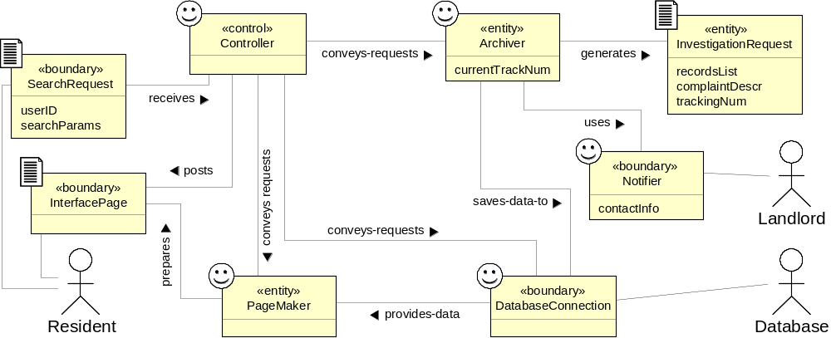
Domain Model (4)
Domain model
for UC-5: Inspect Access History

Slide 18
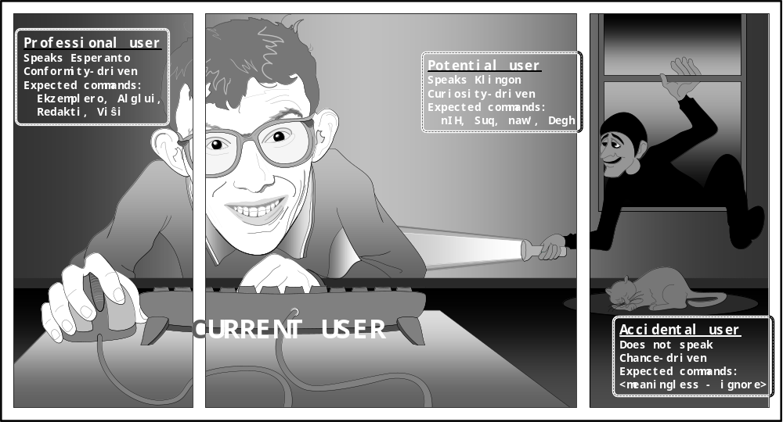
Domain Analysis:
Looking from Inside Out

Slide 19
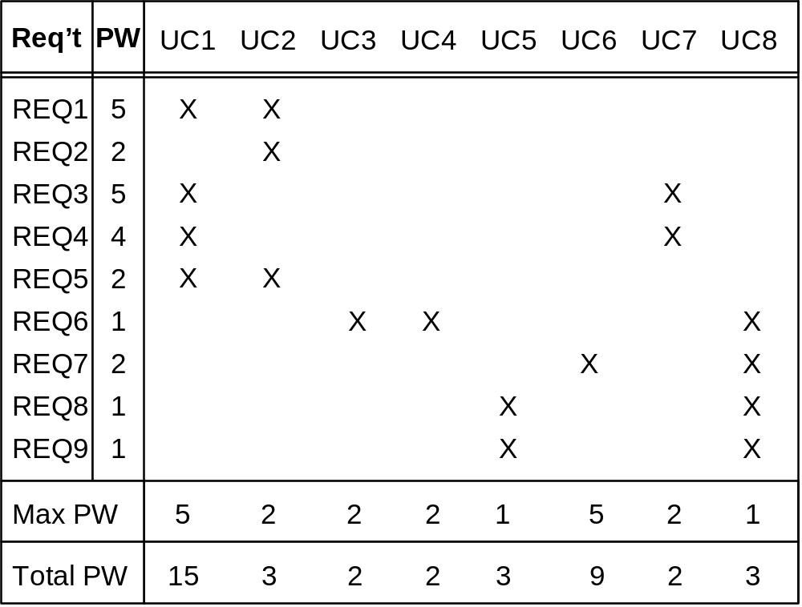
Traceability Matrix (1)
Mapping: System requirements to Use cases
UC1: Unlock
UC2: Lock
UC3: AddUser
UC4: RemoveUser
UC5: InspectAccessHistory
UC6: SetDevicePrefs
UC7: AuthenticateUser
UC8: Login
REQ1: Keep door locked and auto-lock
REQ2: Lock when “LOCK” pressed
REQ3: Unlock when valid key provided
REQ4: Allow mistakes but prevent dictionary attacks
REQ5: Maintain a history log
REQ6: Adding/removing users at runtime
REQ7: Configuring the device activation preferences
REQ8: Inspecting the access history
REQ9: Filing inquiries

Slide 20
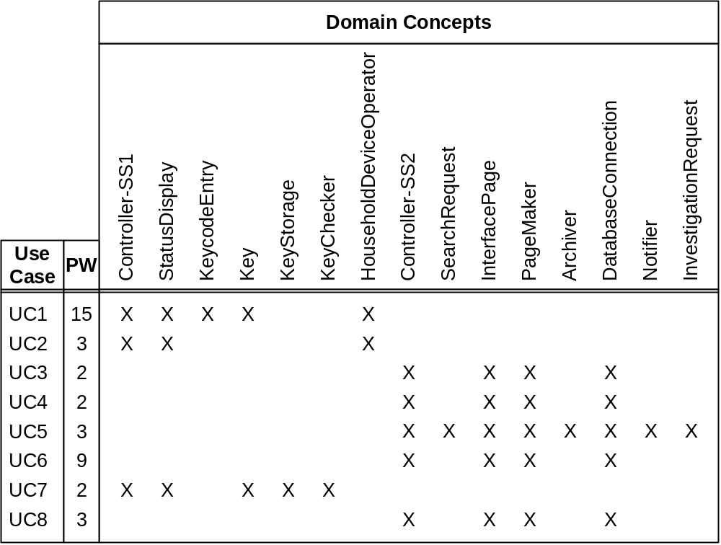
Traceability Matrix (2)
Mapping: Use cases to Domain model
UC1: Unlock
UC2: Lock
UC3: AddUser
UC4: RemoveUser
UC5: InspectAccessHistory
UC6: SetDevicePrefs
UC7: AuthenticateUser
UC8: Login

Slide 21
Contracts:
Preconditions and Postconditions
Operation | Unlock
Preconditions | • set of valid keys known to the system is not empty
 | • numOfAttempts < maxNumOfAttempts
 | • numOfAttempts = 0, for the first attempt of the current user
Postconditions | • numOfAttempts = 0, if the entered Key ∈ Valid keys
 | • current instance of the Key object is archived and destroyed
Operation | Lock
Preconditions | None (that is, none worth mentioning)
Postconditions | • lockStatus = “armed”, and
 | • lightStatus remains unchanged (see text for discussion)

Slide 22

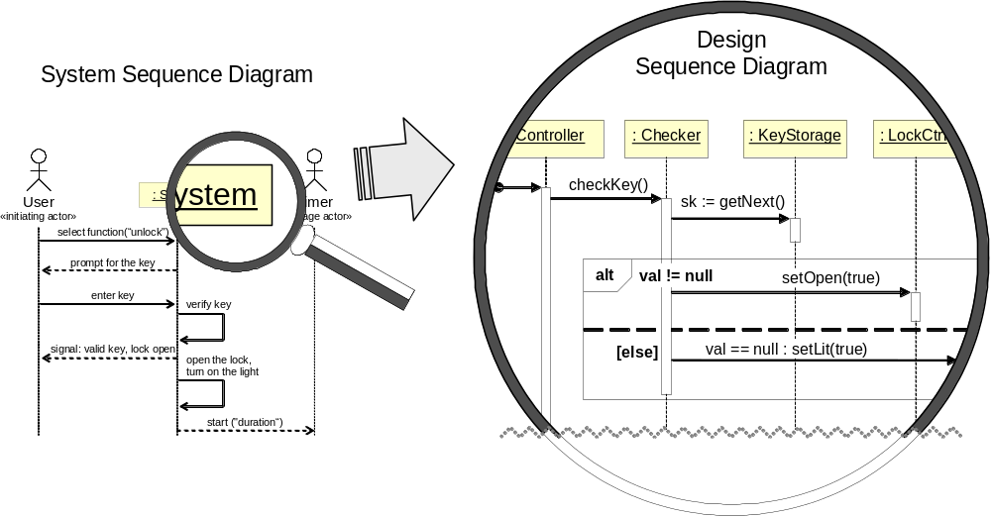
Design: Object Interactions

